Slide 1

Crystallography
H. K. D. H. Bhadeshia
Introduction and point groups
Stereographic projections
Low symmetry systems
Space groups
Reciprocal Lattice & Diffraction
Deformation and texture
Interfaces, orientation relationships
Martensitic transformations

Slide 2
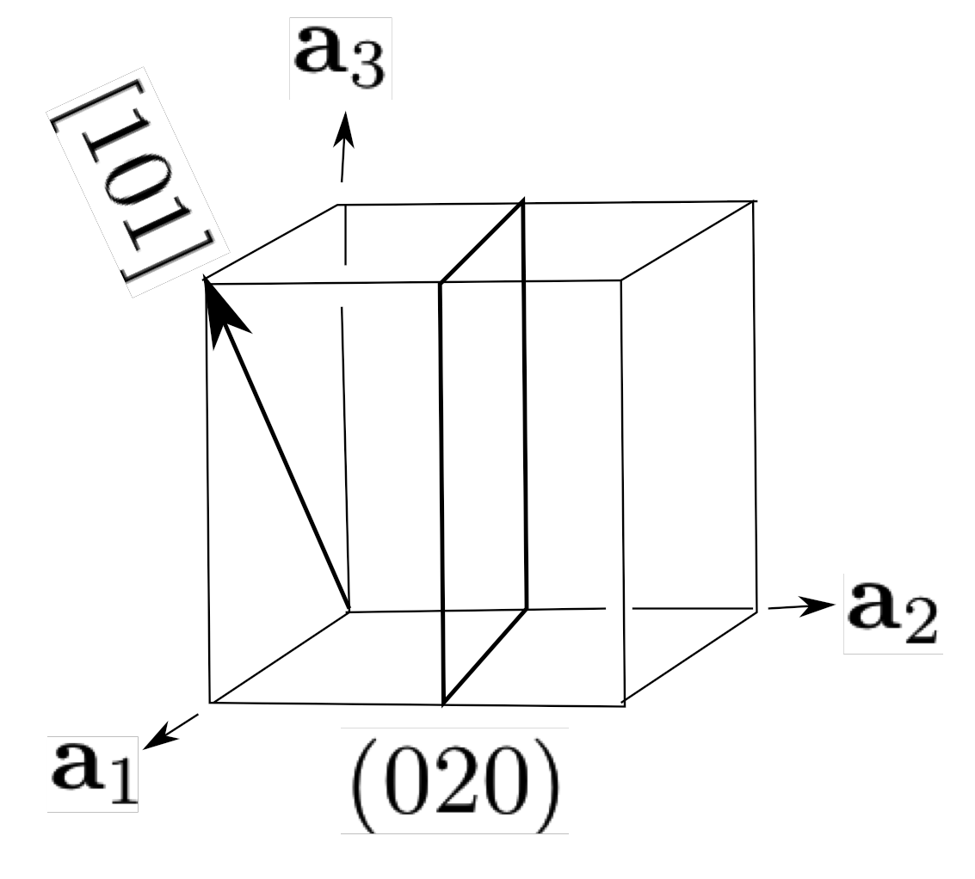



Slide 3
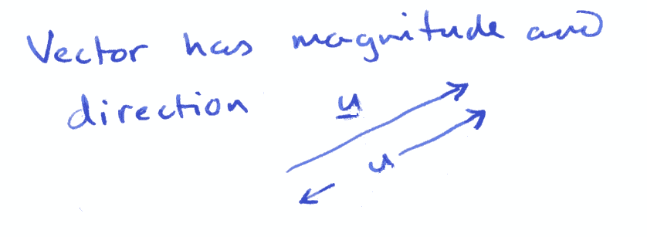

Slide 4
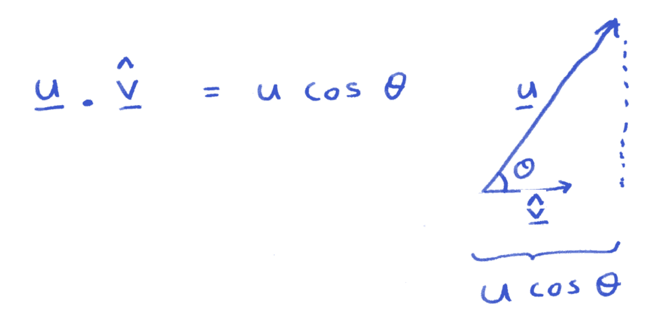

Slide 5
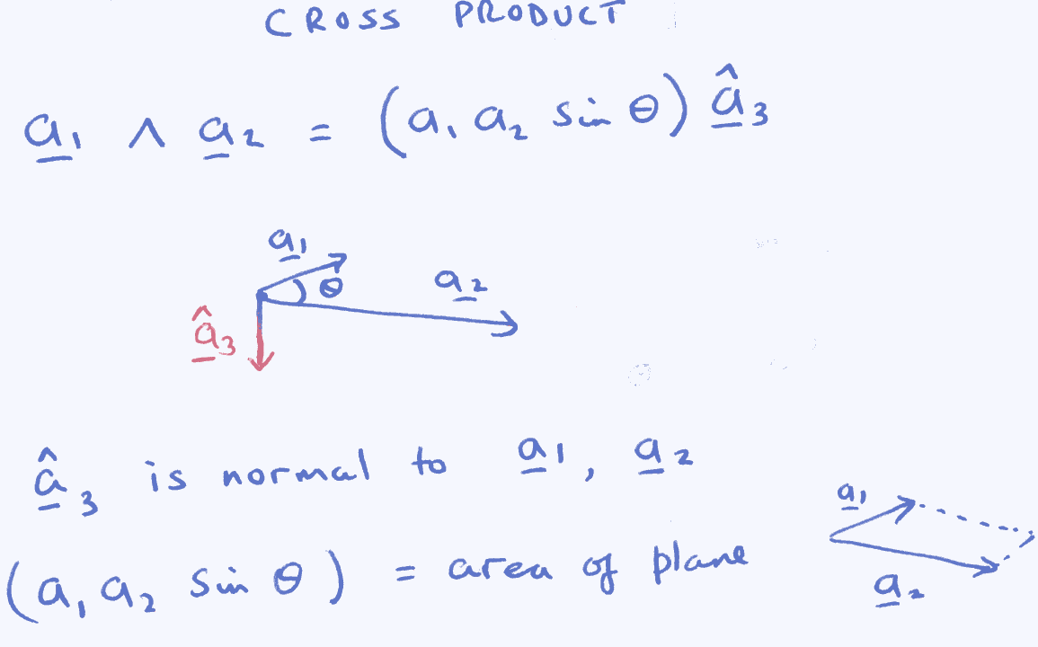

Slide 6
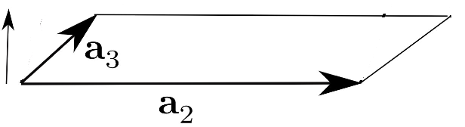

Slide 7
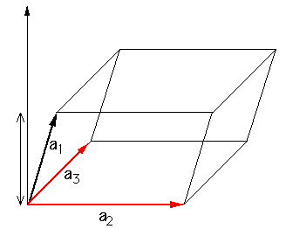

Slide 8
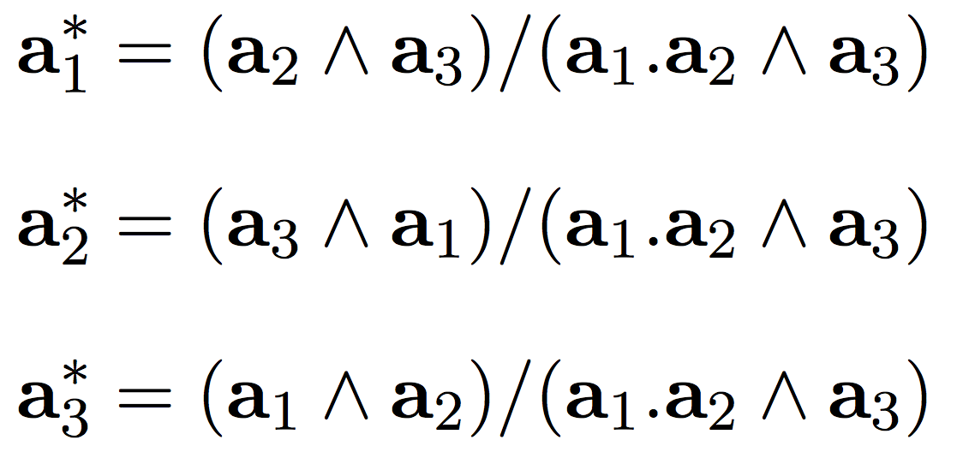

Slide 9
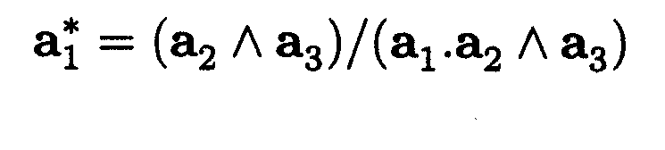
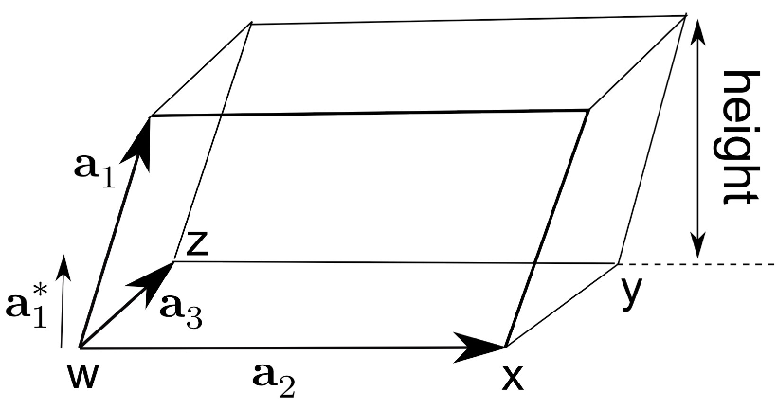

Slide 10
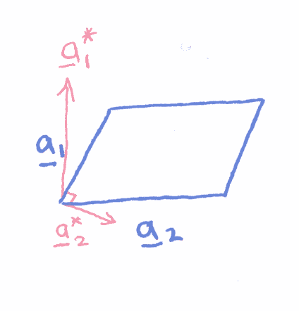

Slide 11
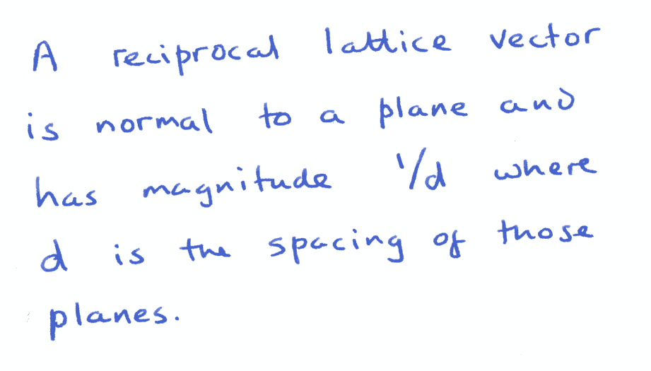

Slide 12
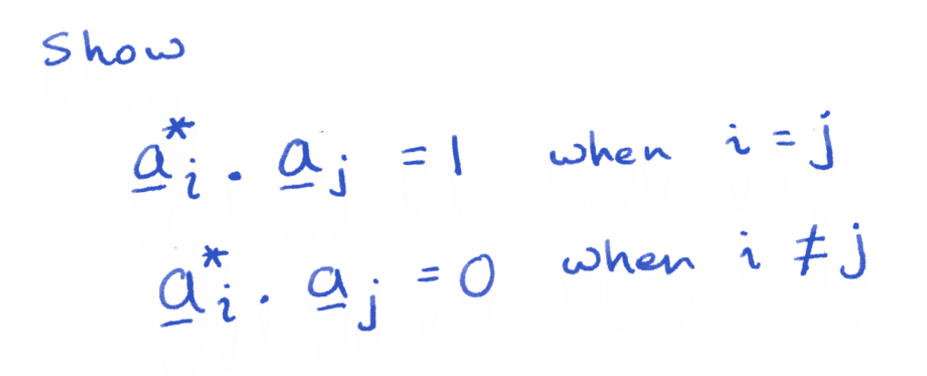

Slide 13
Construct reciprocal
lattice section normal
to [001]

Slide 14
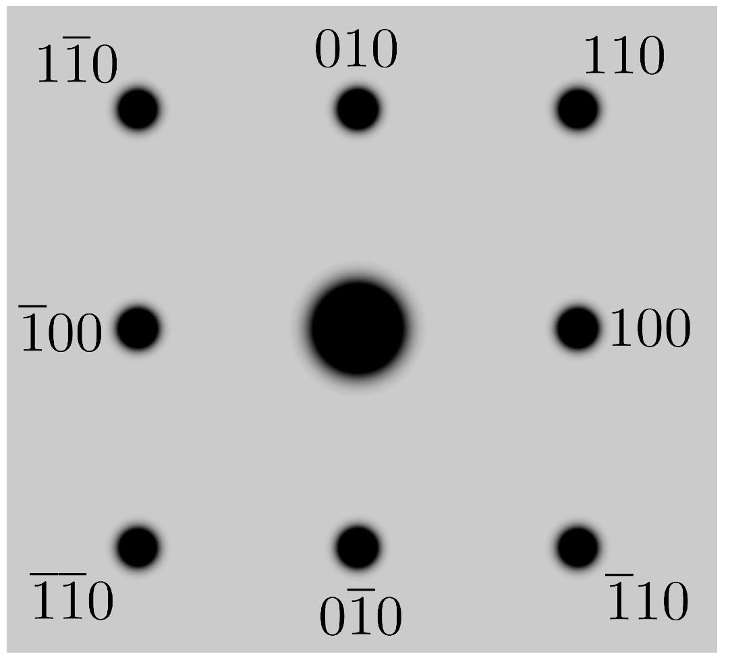
Cubic P, section of reciprocal lattice normal to [001]

Slide 15
Reciprocal
lattice
section
normal
to [110]

Slide 16
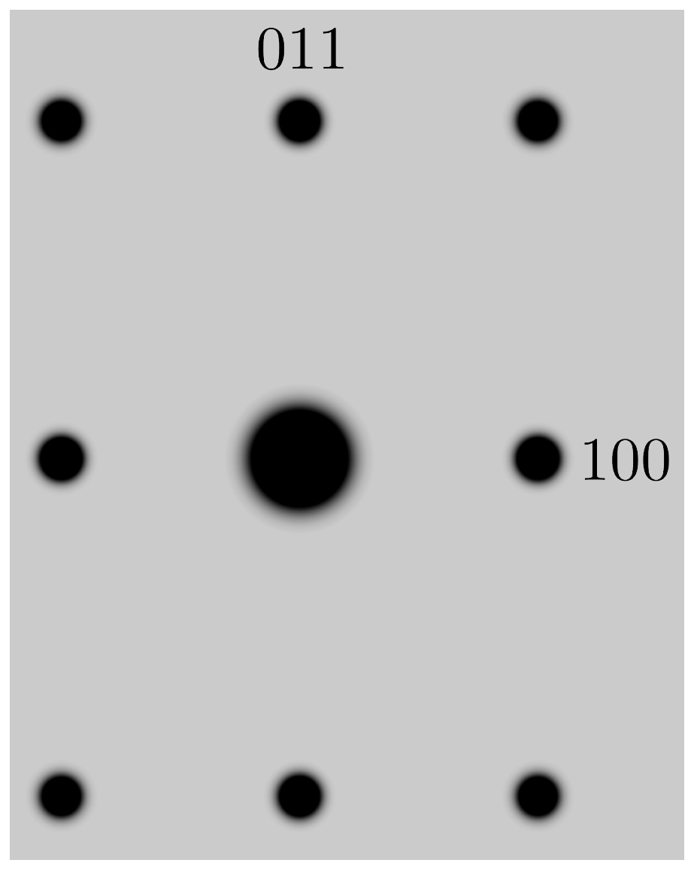
Cubic P, section of reciprocal lattice normal to [110]
_
110
001

Slide 18
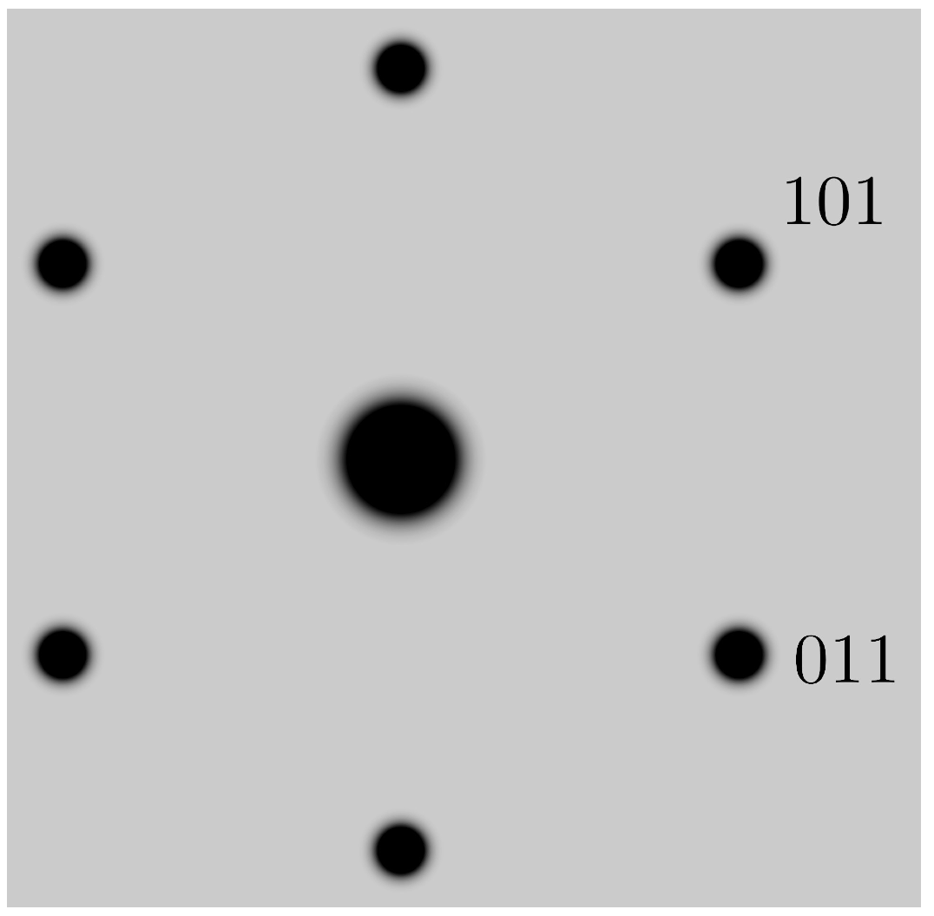
Cubic P, section of reciprocal lattice normal to [111]
_
110
_

Slide 19
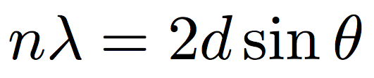
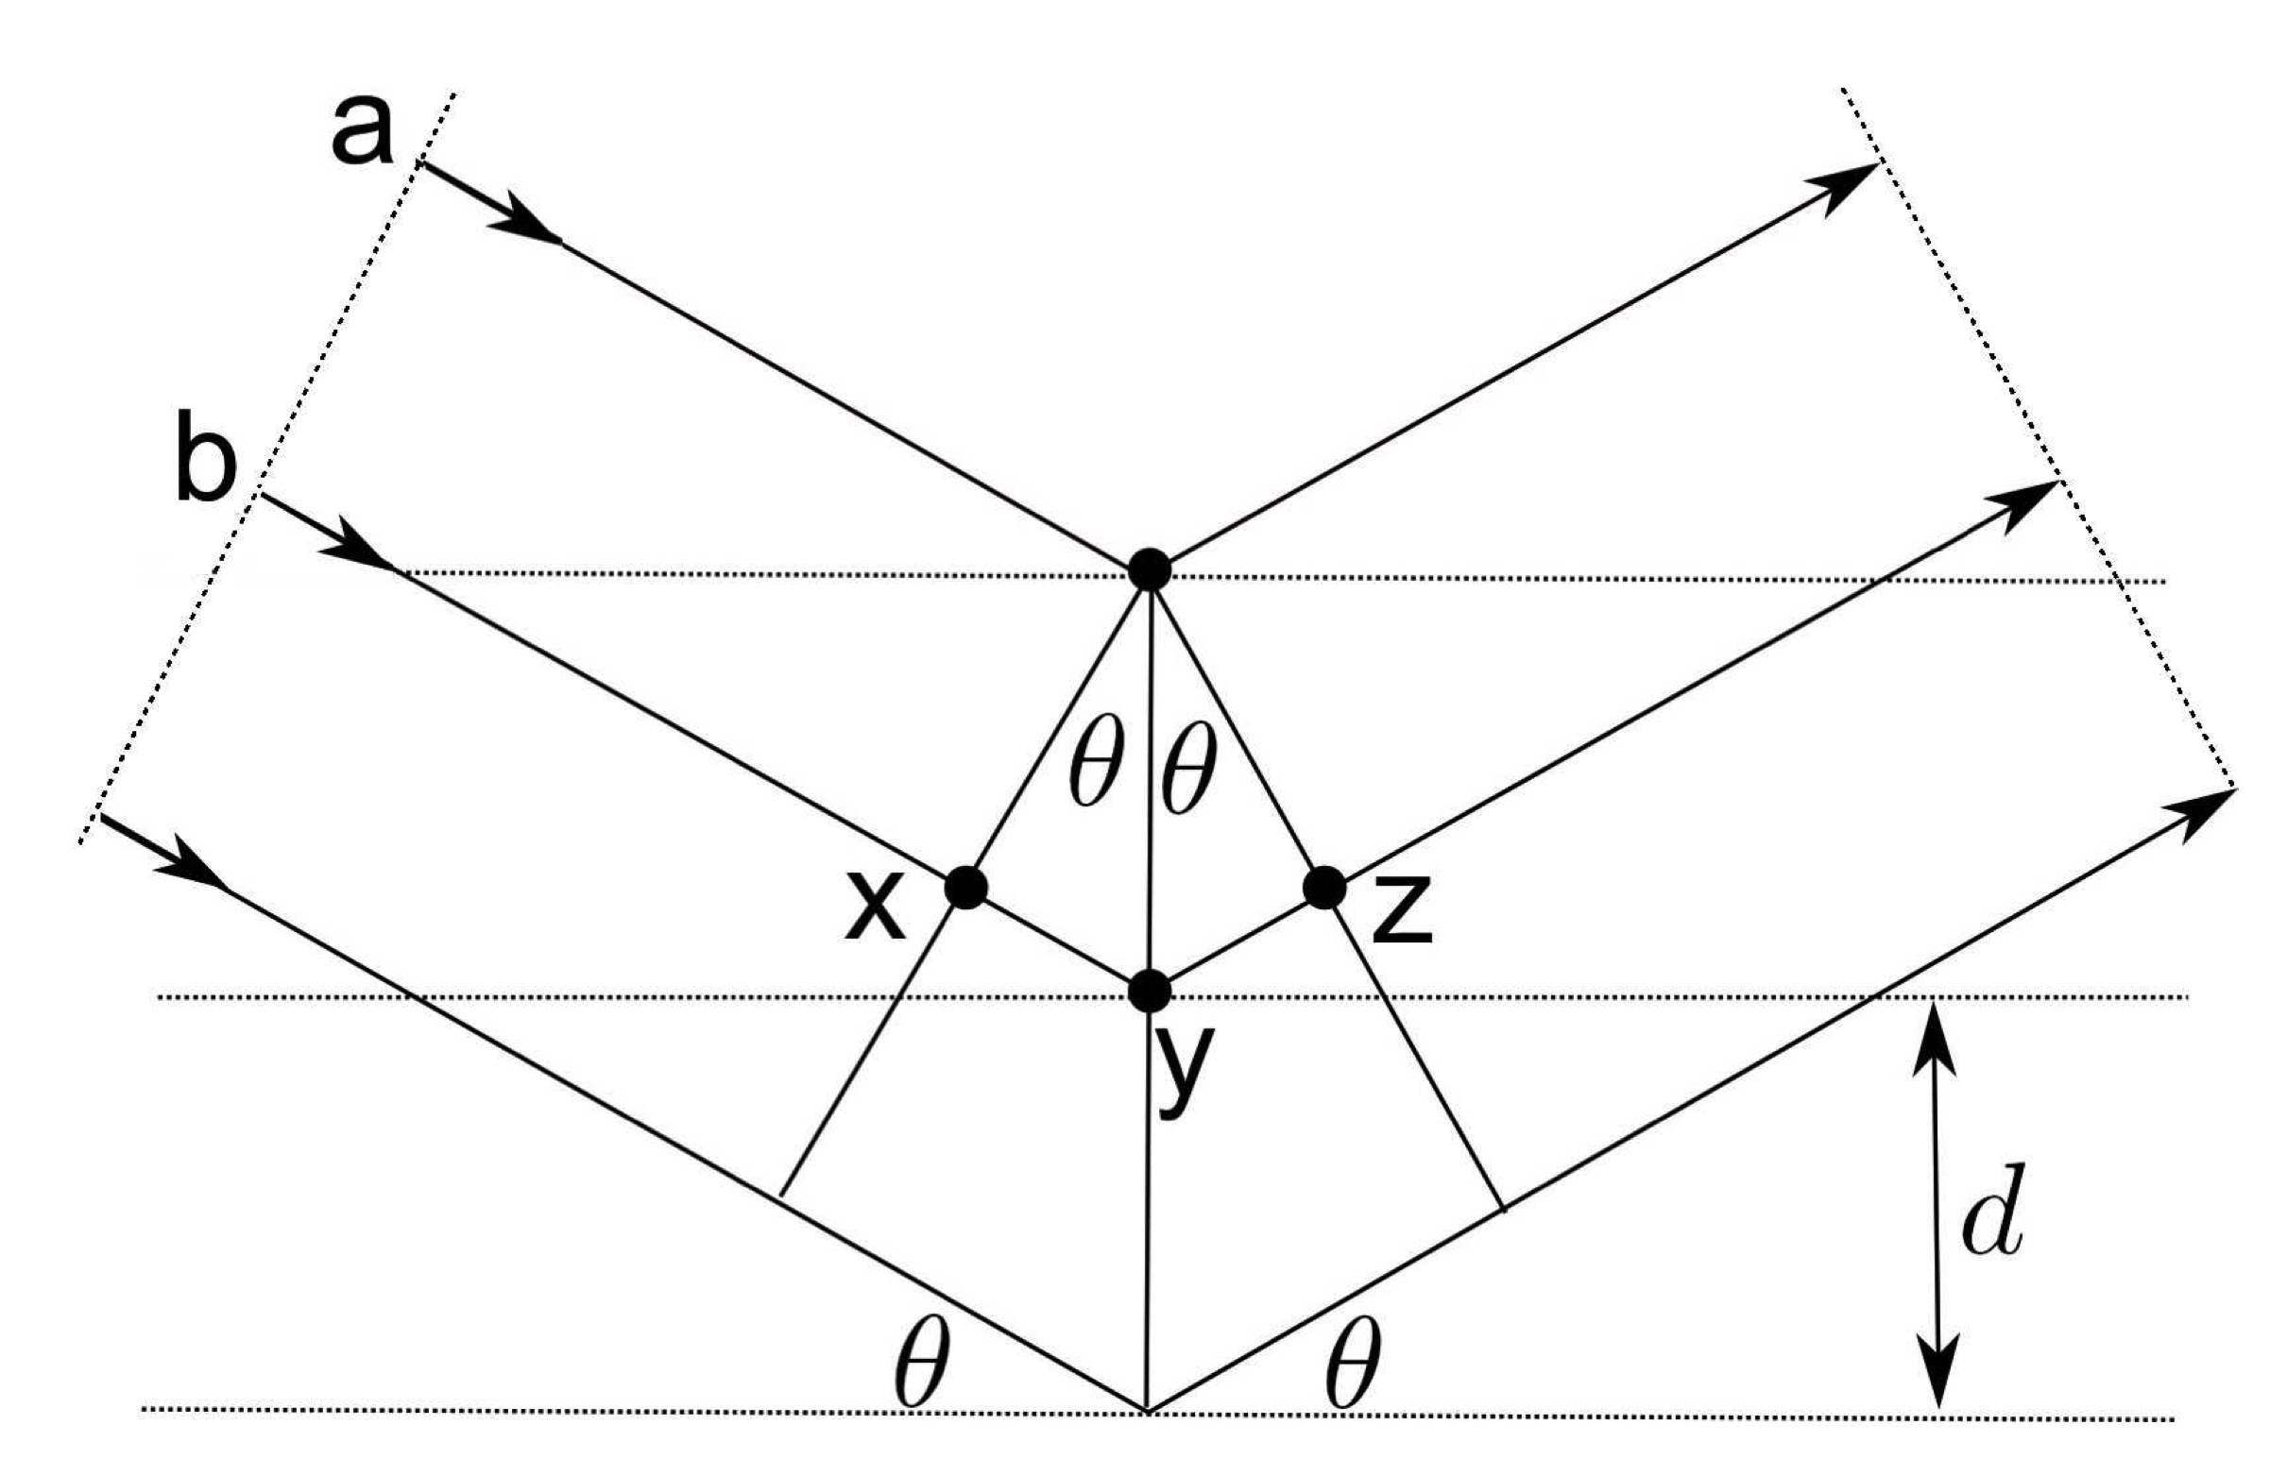

Slide 20
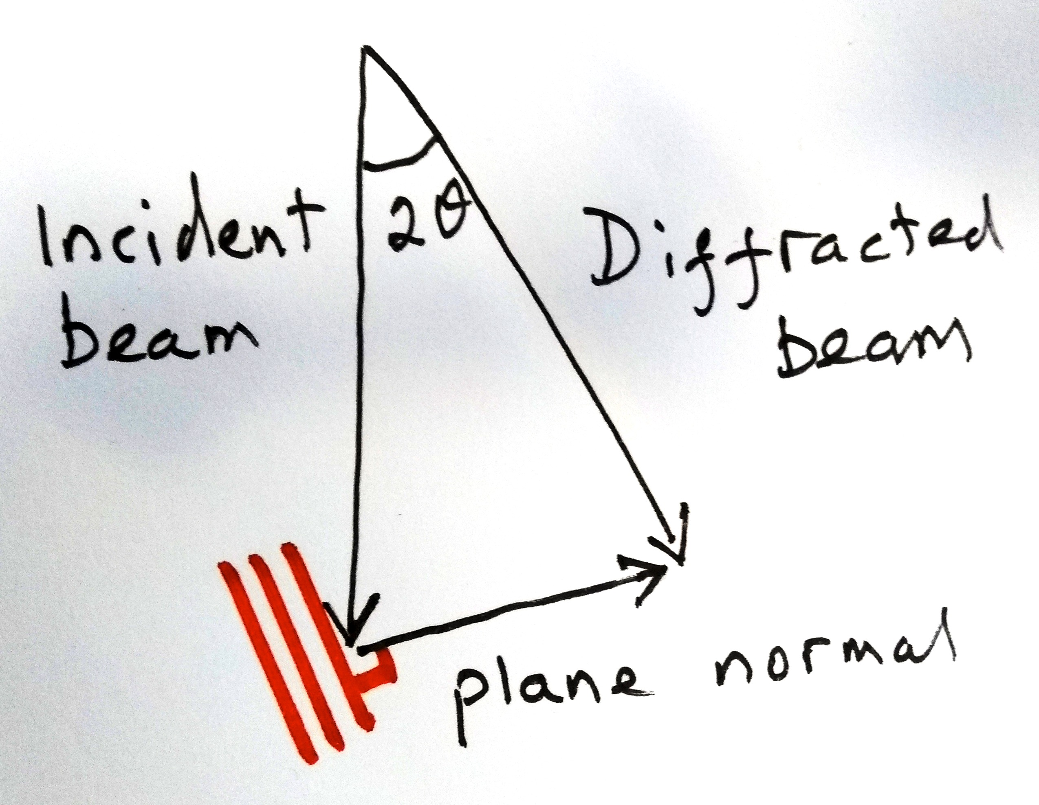

Slide 21
For 100 keV accelerating voltage, the wavelength of electrons is 0.0037 nm.
If the d spacing is 0.2 nm, then the Bragg angle is just 0.5°
Consider now the Bragg law in reciprocal space

Slide 22
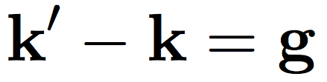
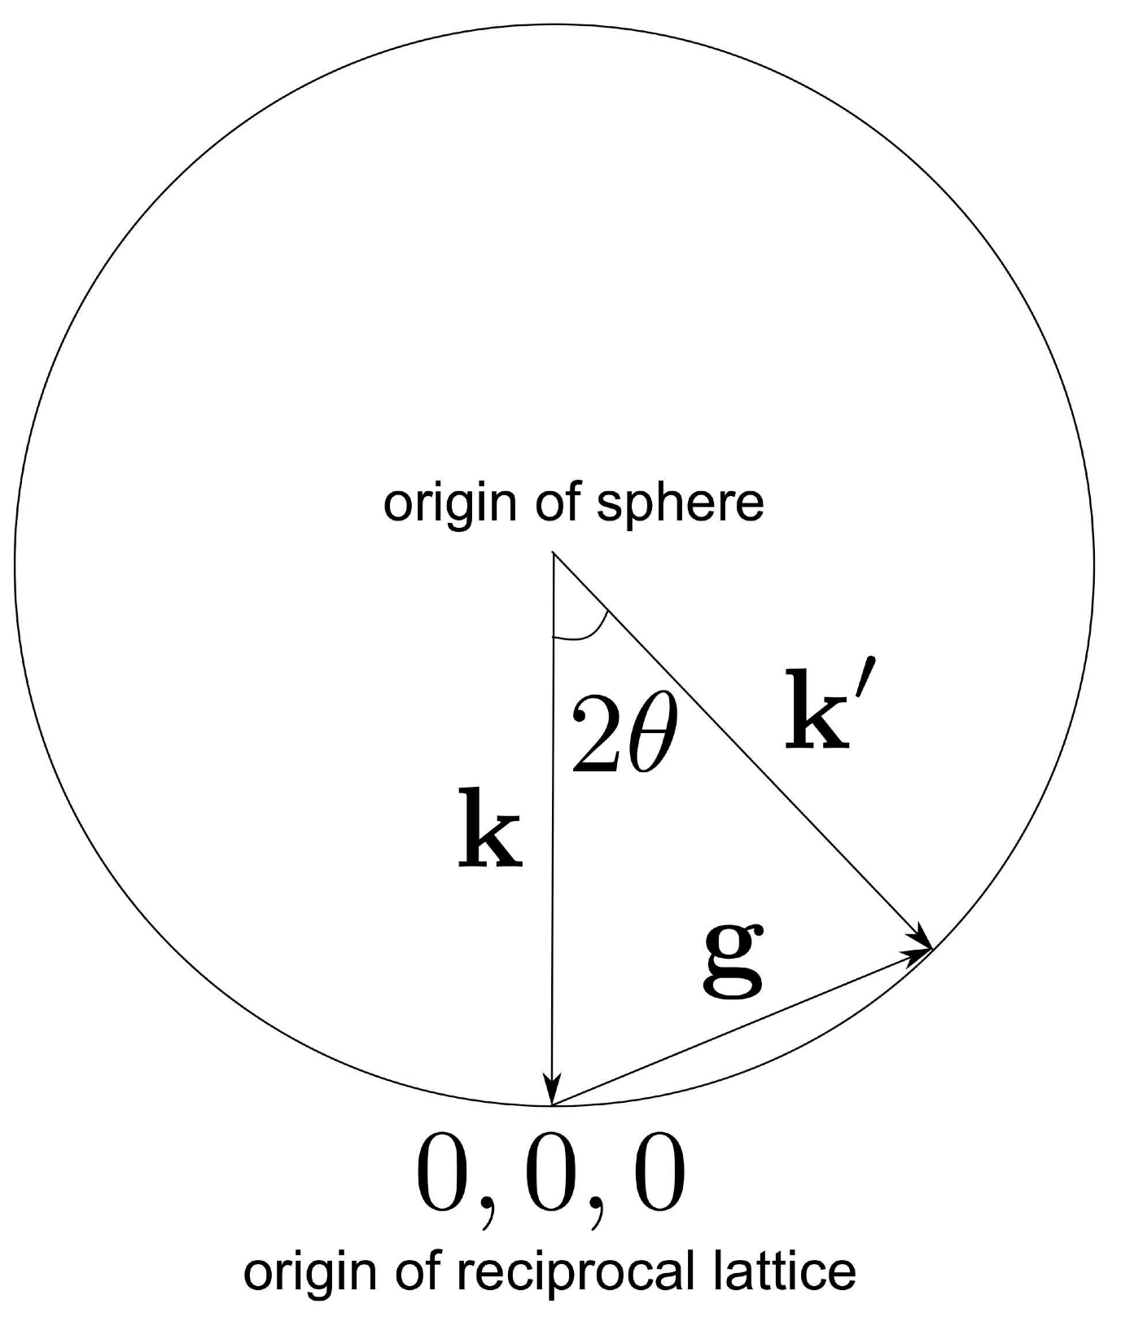



Slide 23
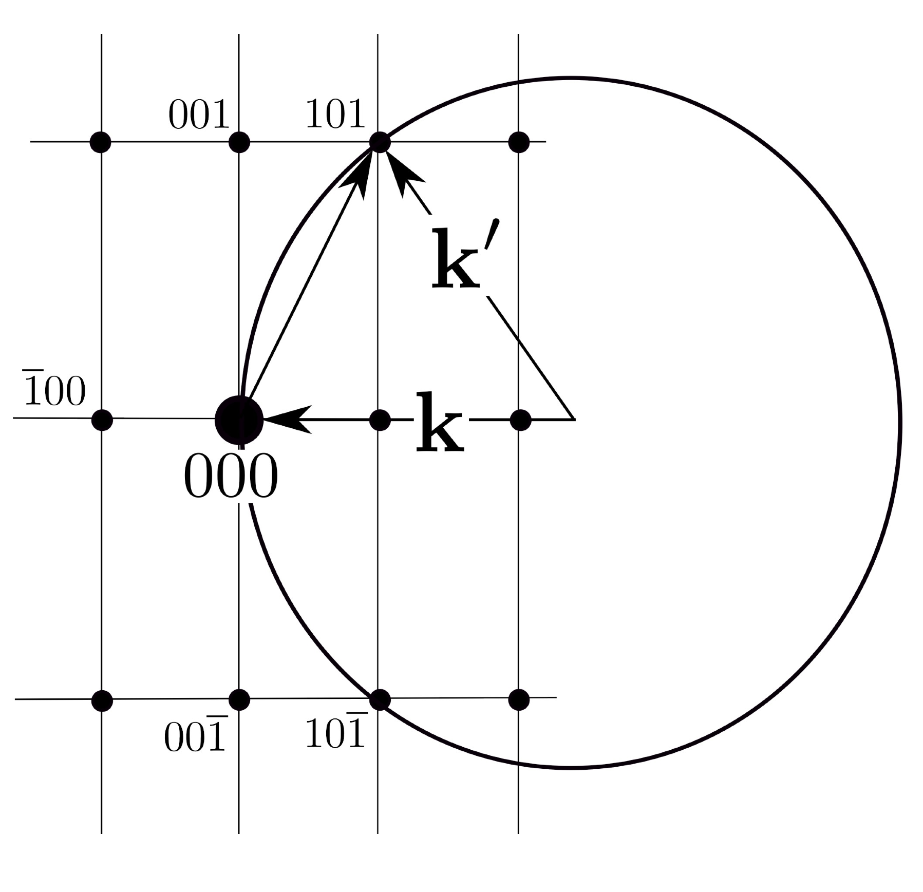

Slide 24
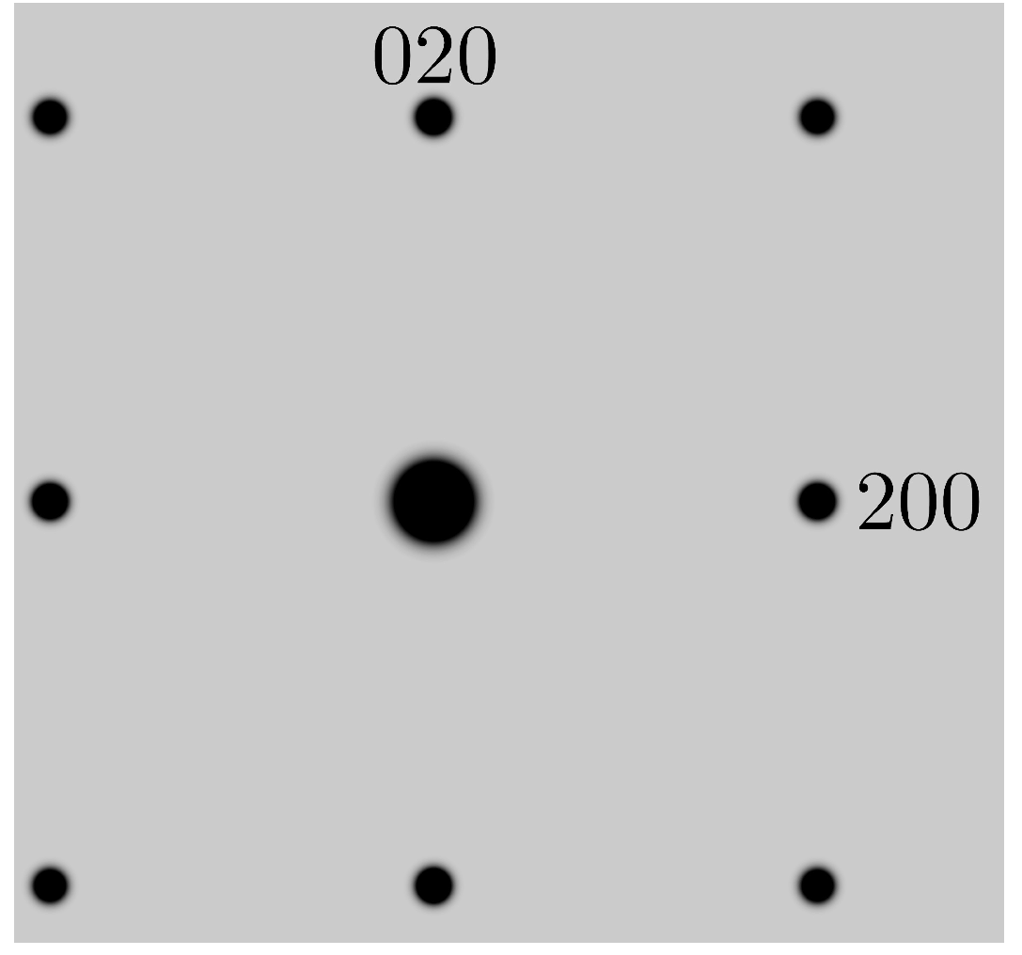
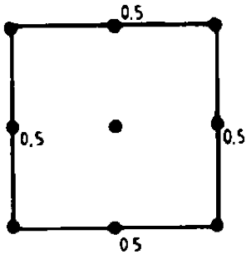

Cubic P
Cubic F

Slide 25
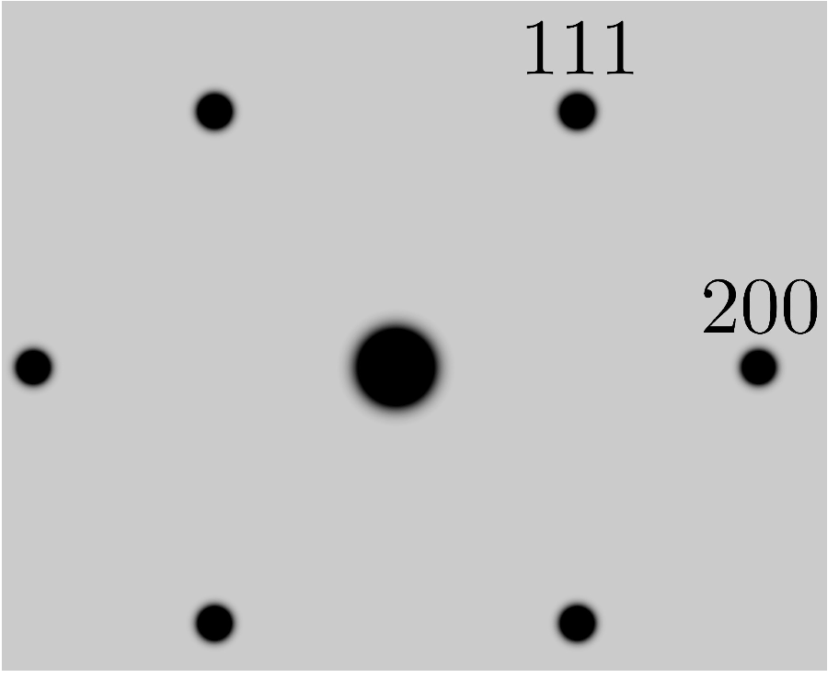
_
Cubic P [011]
Cubic F
111

Slide 26
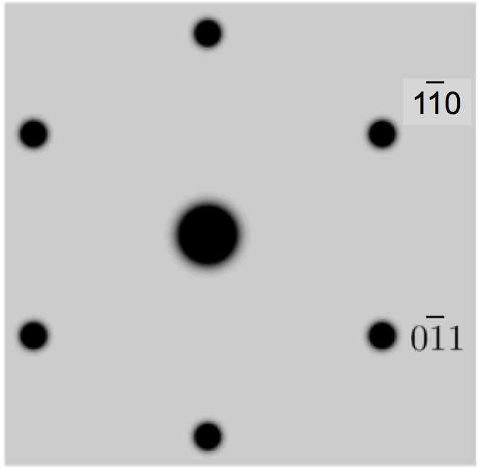
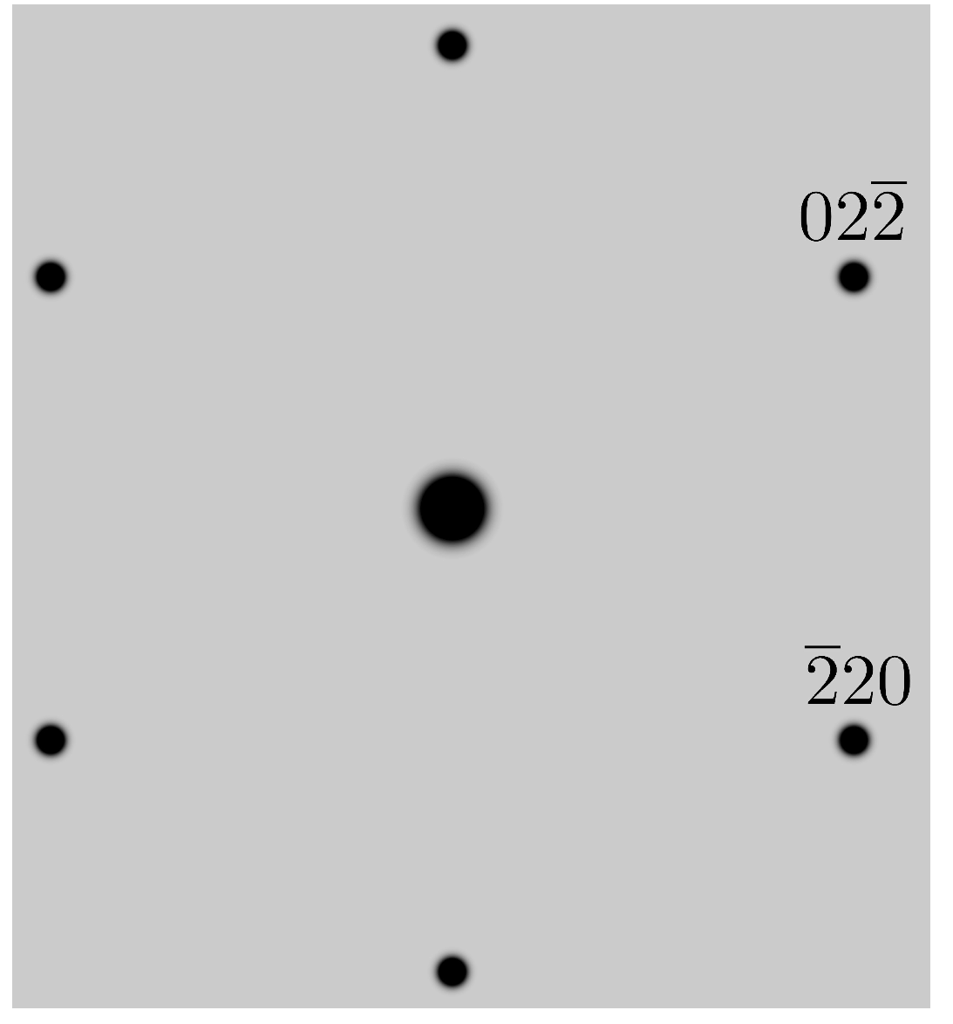
Cubic P [111]
Cubic F
_
220
_
022

Slide 27
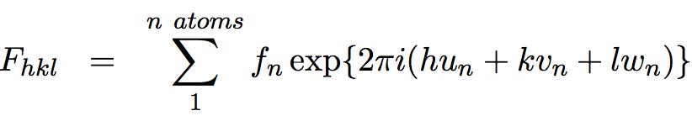


Slide 28
Diffraction from thin crystals

Slide 29
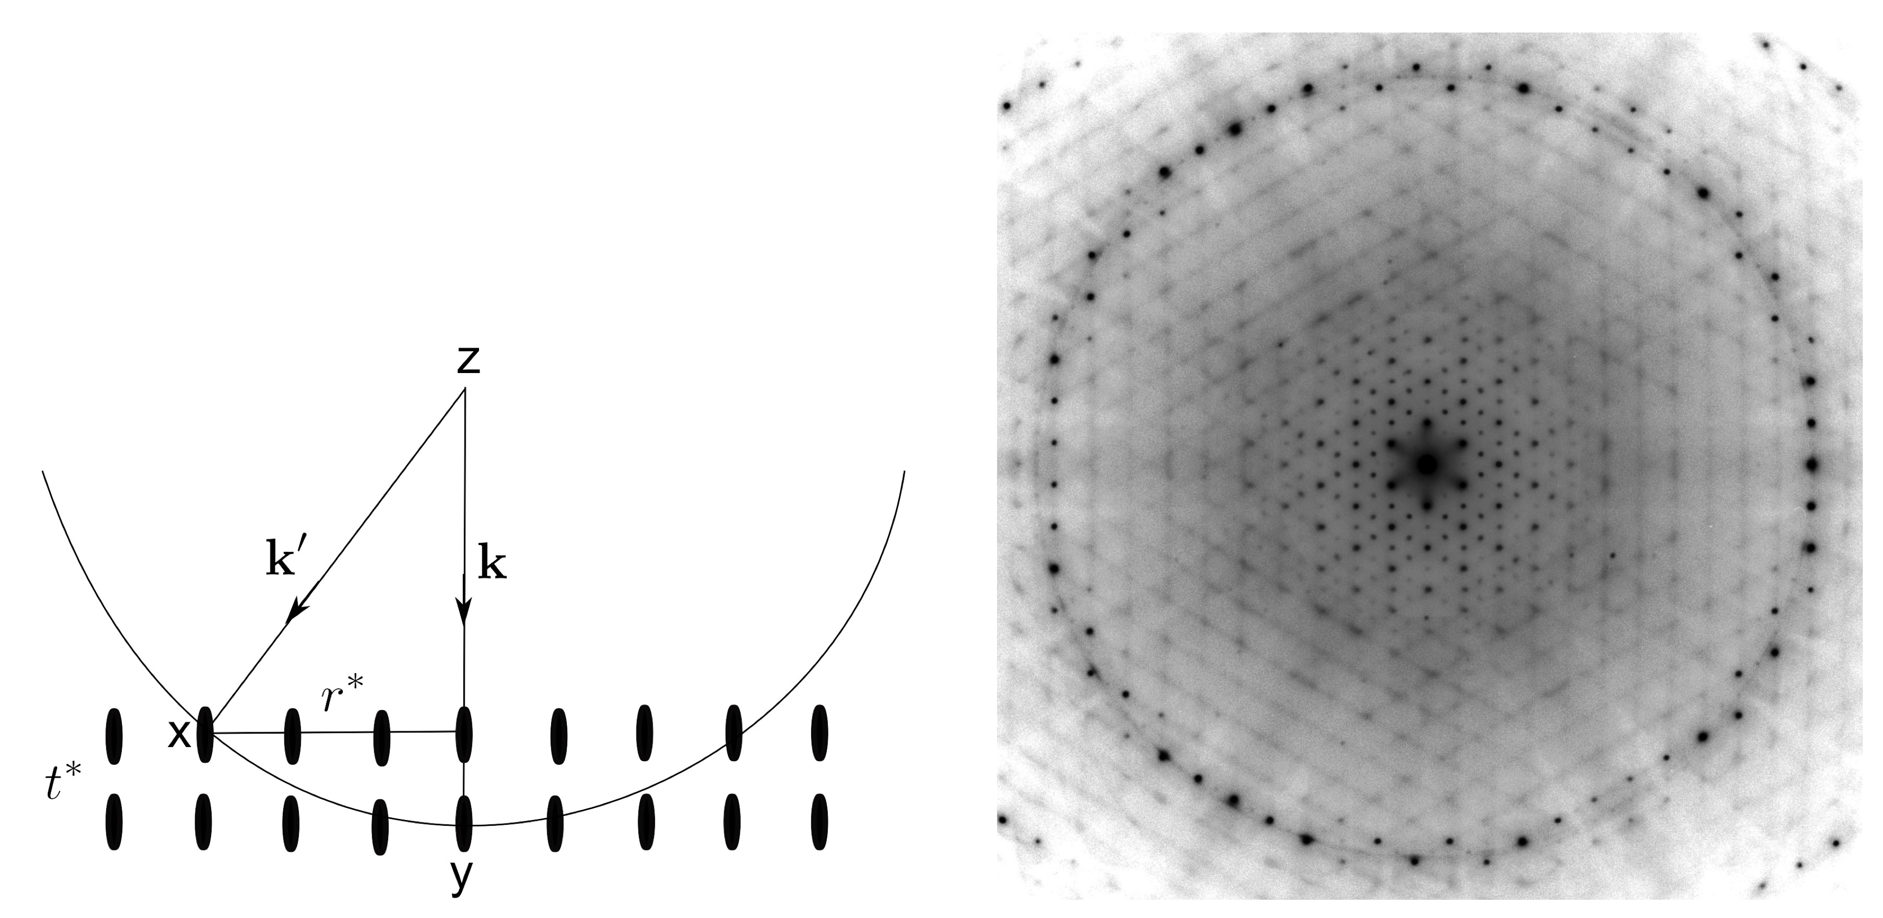

Slide 30
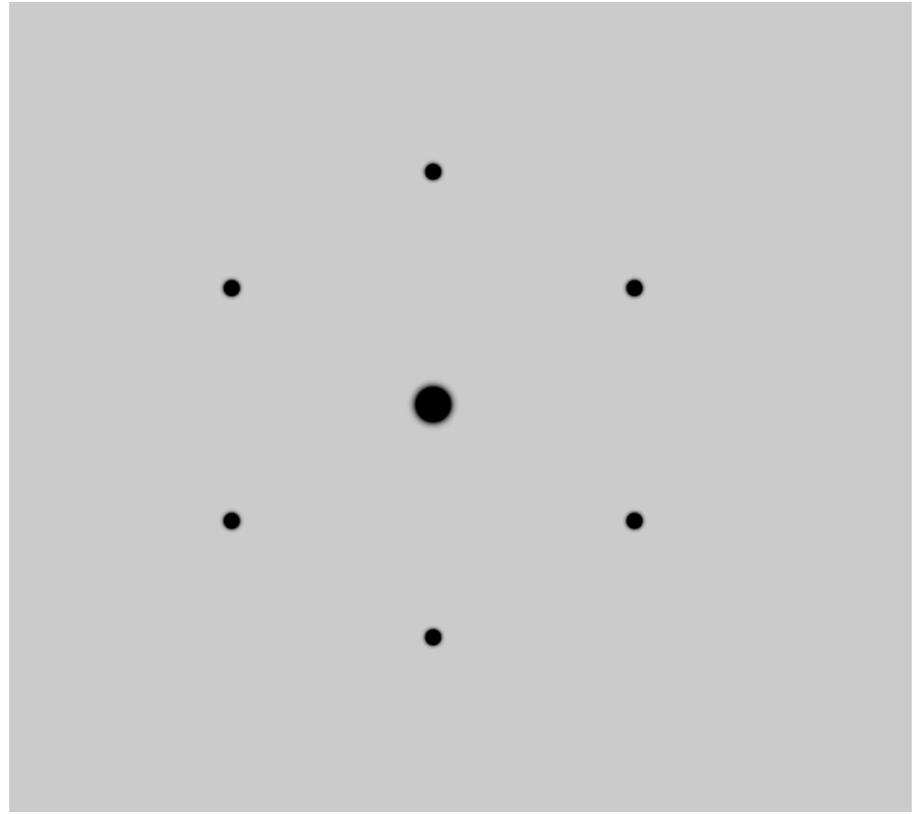
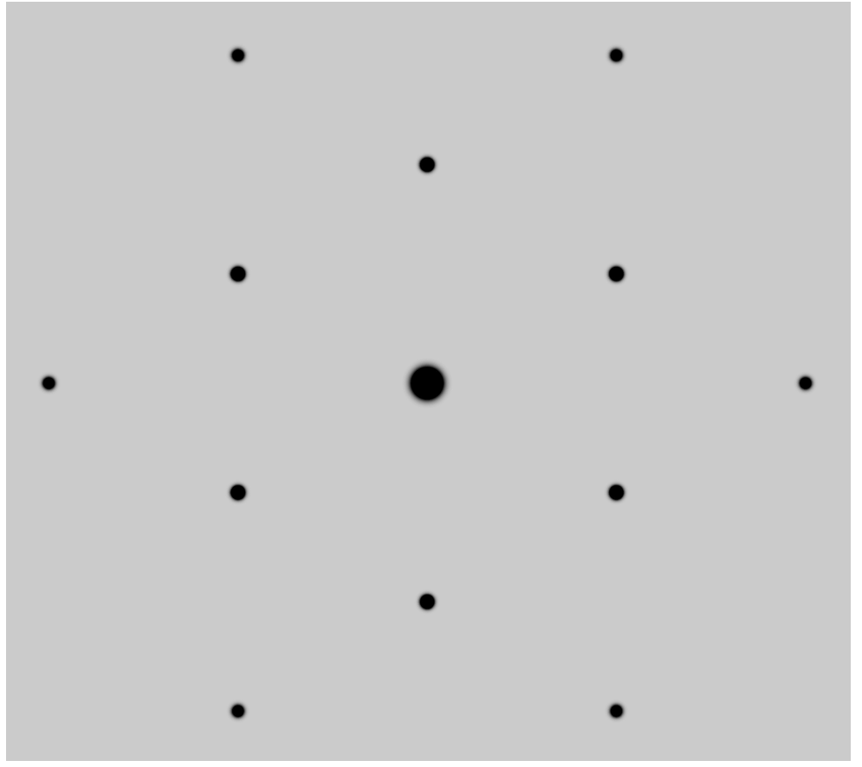
200 nm thick foil
50 nm thick foil

Slide 31
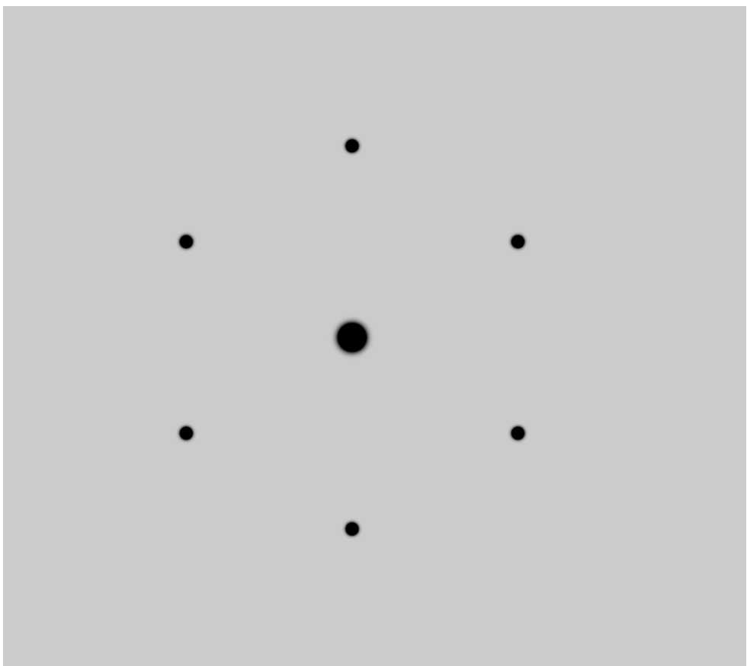
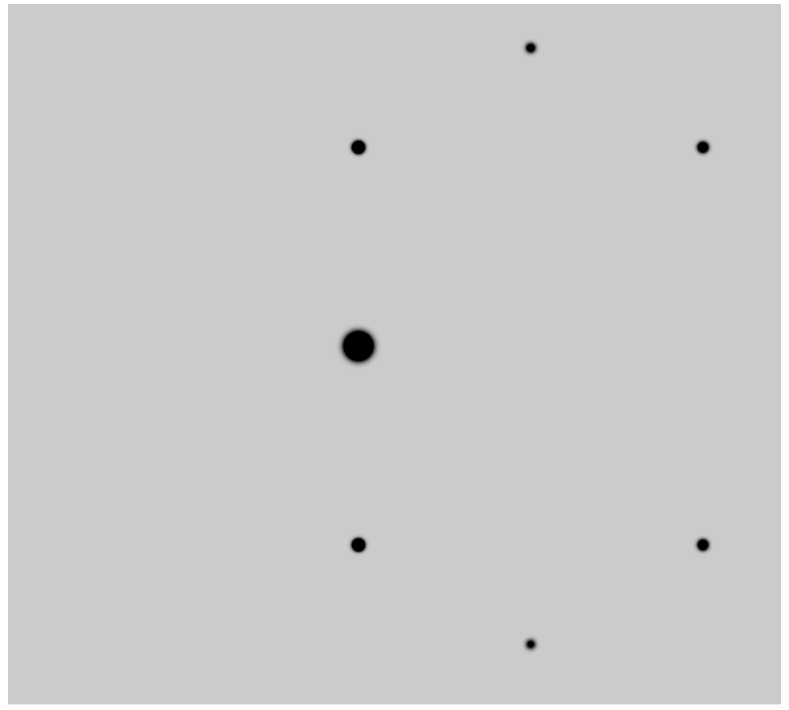
[111]
[1 1 0.9]

Slide 32
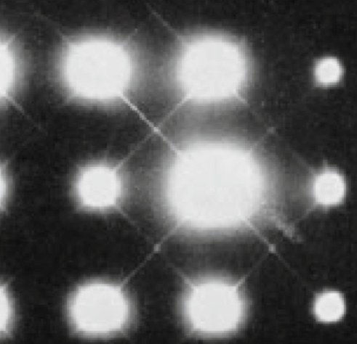
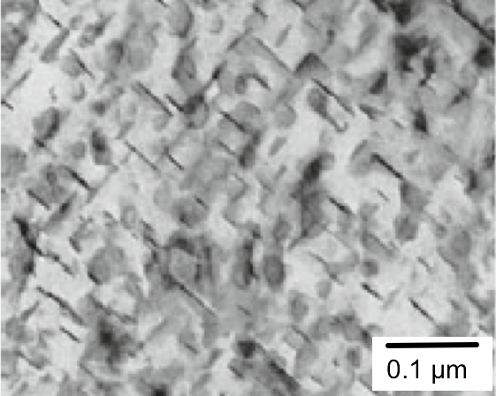
(R. Herring)

Slide 33
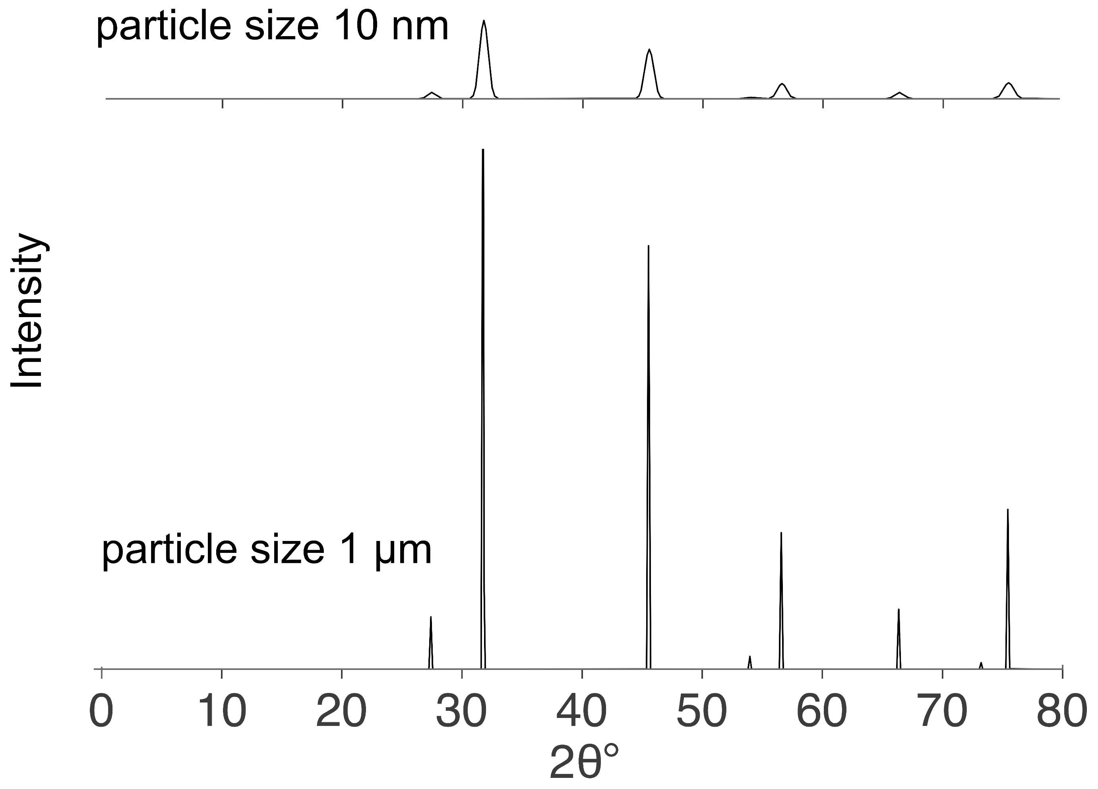

Slide 34
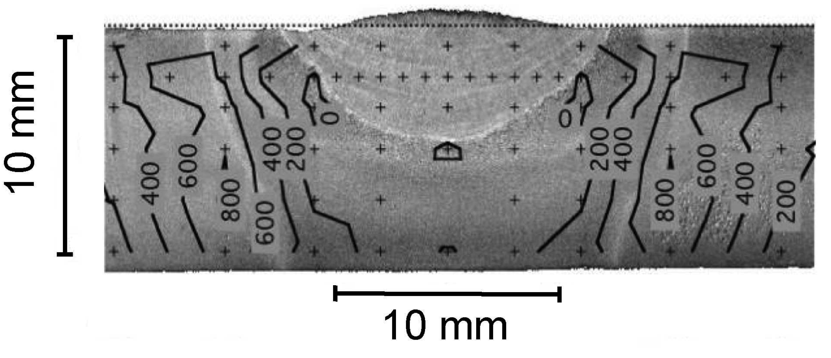

Slide 35
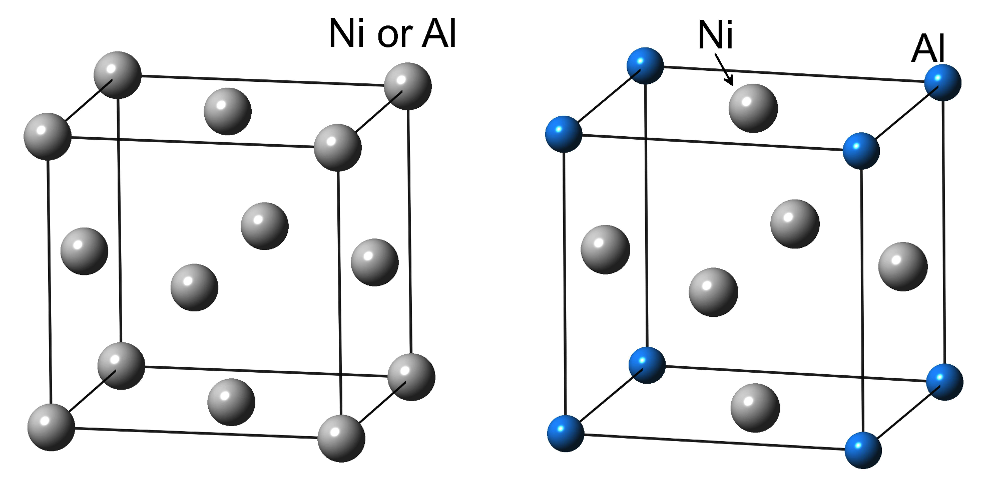
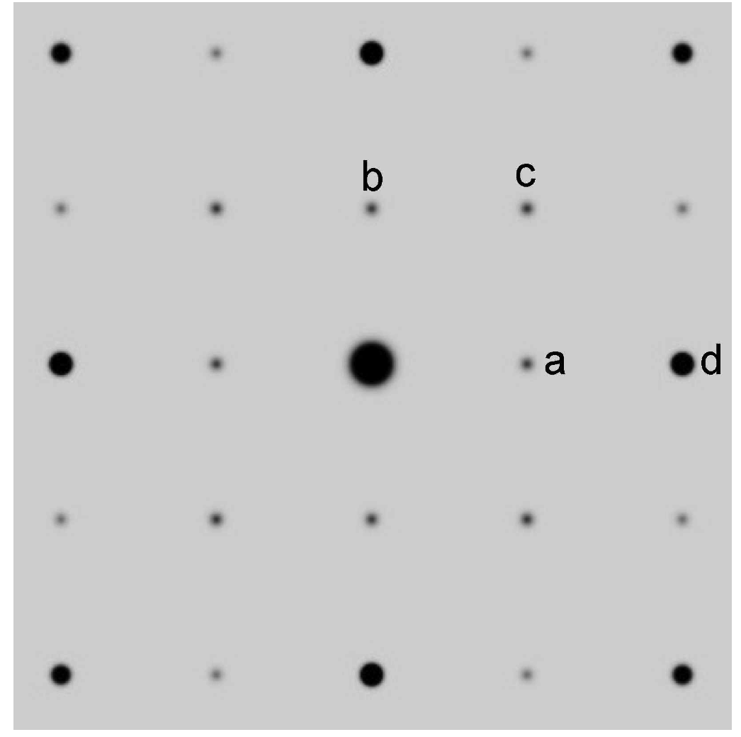
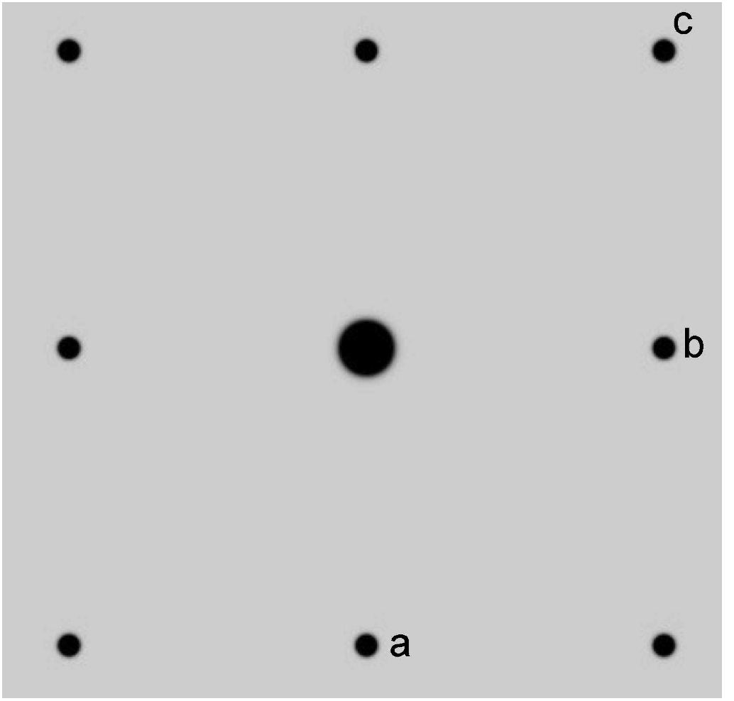

Slide 36
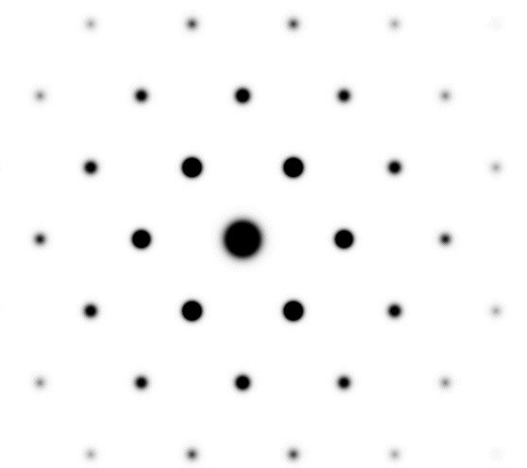
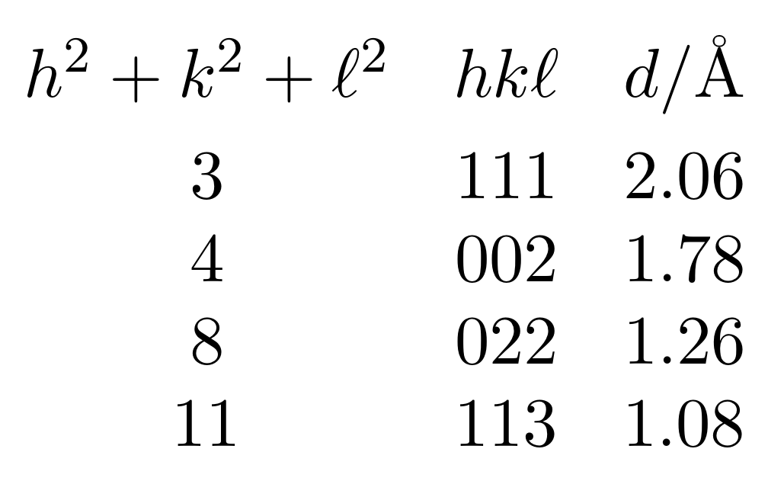
Cubic-F
lattice parameter 3.566 Å

Slide 38
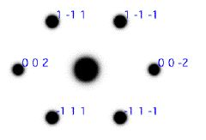

Slide 39

Su et al.
2014

