Slide 1
Phase transitions
The iron-carbon system
Harry Bhadeshia
Haixue Yan
photograph courtesy of Sunita Hansraj from her Antarctica expedition

Slide 2
ISSUES TO ADDRESS...
• Transforming one phase into another takes time.
Fe
γ
Fe₃C
Eutectoid
transformation
(cementite)
(Austenite)
+
α
C
FCC
(ferrite)
(BCC)
• How does the rate of transformation depend on
time and temperature?
• Is it possible to slow down transformations so that
non-equilibrium structures are formed?
• Are the mechanical properties of non-equilibrium
structures more desirable than equilibrium ones?

Slide 3
Fe-C True Equilibrium Diagram
T(ºC)
1600
1400
L
Liquid +
Graphite
γ
+L
1200
γ
1153ºC
Austenite
4.2 wt% C
1000
α + γ
γ + Graphite
800
740ºC
600
0.65
Cementite Fe₃C is a metastable compound.
α + Graphite
400
Fe₃C → 3Fe (α-ferrite) + C (graphite)
0
1
2
3
4
90
100
(Fe)
C, wt% C
Graphite formation promoted by
Si > 1 wt%
slow cooling
Adapted from Fig. 11.2, Callister & Rethwisch 8e.
[Fig. 11.2 adapted from Binary Alloy Phase Diagrams, 2nd ed.,
Vol. 1, T.B. Massalski (Ed.-in-Chief), ASM International, Materials Park, OH, 1990.]

Slide 4
Transformations & Undercooling
•
Eutectoid transf. (Fe-Fe₃C system):
γ
⇒
α
+
Fe₃C
•
For transf. to occur, must
cool to below 727ºC
(i.e., must “undercool”)
0.76 wt% C
6.7 wt% C
0.022 wt% C
T(ºC)
1600
Adapted from Fig. 9.24,Callister & Rethwisch 8e. (Fig. 9.24 adapted from Binary Alloy Phase Diagrams, 2nd ed., Vol. 1, T.B. Massalski (Ed.-in-Chief), ASM International, Materials Park, OH, 1990.)
δ
1400
L
γ
γ
+L
1200
(austenite)
1148ºC
L+Fe₃C
α
1000
γ
+Fe₃C
Eutectoid:
Fe₃C (cementite)
ferrite
800
Equil. Cooling: T_{transf.} = 727ºC
ΔT
727ºC
α
+Fe₃C
600
Undercooling by T_{transf.} < 727°C
400
0.022
0.76
0
1
2
3
4
5
6
6.7
(Fe)
C, wt%C

Slide 5
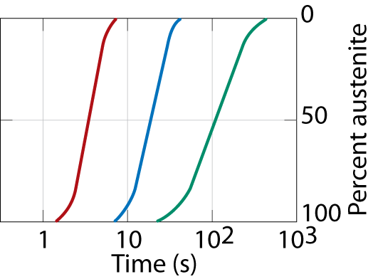
The Fe-Fe₃C Eutectoid Transformation
• Transformation of austenite to pearlite:
Diffusion of C
during transformation
Austenite (γ)
cementite (Fe₃C)
grain
α
Ferrite (α)
α
boundary
α
γ
γ
α
γ
γ
Adapted from Fig. 9.15, Callister & Rethwisch 8e.
α
pearlite
α
α
α
growth
direction
α
Carbon diffusion
• For this transformation,
rate increases with
[T_{eutectoid} – T ] (i.e., ΔT).
100
600ºC
(ΔT larger)
50
650ºC
Adapted from Fig. 10.12, Callister & Rethwisch 8e.
y (% pearlite)
675ºC
(ΔT smaller)
0
Coarse pearlite → formed at higher temperatures – relatively soft
Fine pearlite → formed at lower temperatures – relatively hard

Slide 6
Generation of Isothermal Transformation Diagrams
Time-Temperature-Transformation (TTT) Diagrams
Consider:
• The Fe-Fe₃C system, for C₀ = 0.76 wt% C
• A transformation temperature of 675ºC.
100
T = 675ºC
% transformed
y,
50
0
2
4
1
10
10
time (s)
T(ºC)
Austenite (stable)
T_{E} (727ºC)
700
Austenite
(unstable)
600
Pearlite
Adapted from Fig. 10.13,Callister & Rethwisch 8e. (Fig. 10.13 adapted from H. Boyer (Ed.) Atlas of Isothermal Transformation and Cooling Transformation Diagrams, American Society for Metals, 1977, p. 369.)
isothermal transformation at 675ºC
500
50%
100%
0%pearlite
400
time (s)
1
10
10
2
10
3
10
4
10
5

Slide 7
Austenite-to-Pearlite Isothermal Transformation
• Eutectoid composition, C₀ = 0.76 wt% C
• Begin at T > 727ºC
• Rapidly cool to 625ºC
• Hold T (625ºC) constant (isothermal treatment)
T(ºC)
Austenite (stable)
T_{E} (727ºC)
700
Austenite
(unstable)
Adapted from Fig. 10.14,Callister & Rethwisch 8e. (Fig. 10.14 adapted from H. Boyer (Ed.) Atlas of Isothermal Transformation and Cooling Transformation Diagrams, American Society for Metals, 1997, p. 28.)
600
Pearlite
γ
γ
γ
γ
γ
γ
500
50%
100%
0%pearlite
400
1
10
10
2
10
3
10
4
10
5
time (s)

Slide 8
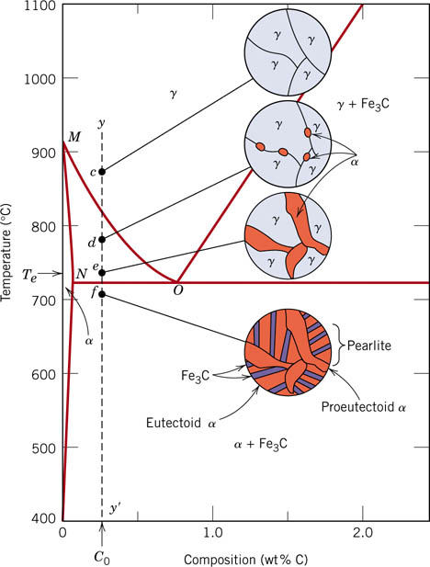
Hypoeutectoid compositions <0.76 wt%C
On cooling the γ must begin to transform as soon as it enters the γ + α phase field.
Pro-eutectoid α is formed on the prior γ grain boundaries;
On cooling to the eutectoid temperature, the remaining γ (which now has the eutectoid composition) transforms to pearlite.
microstructure consists of both proeutectoid ferrite and pearlite.
Notes:
If the composition is above/below the eutectoid what is this called?
The diagram shows allotriomorphic ferrite. This nucleates at the austenite grain boundary. Diffusion along the grain boundaries is faster and the shape is determined by shape of the austenite grain boundaries. 1D growth (normal to the grain boundary plane)
It is possible to form idiomorphic ferrite. This nucleates inside the grain (normally at an inclusion – a non-metallic inclusion). These grains will exhibit crystallographic facets and will typically be equiaxed.
You should be able to understand how to use the phase diagram to show that the composition of the austenite is at the eutectoid composition at the eutectoid temperature.
hypoeutectoid [haɪpəʊjʊ(:)'tektɔɪd]

Slide 9
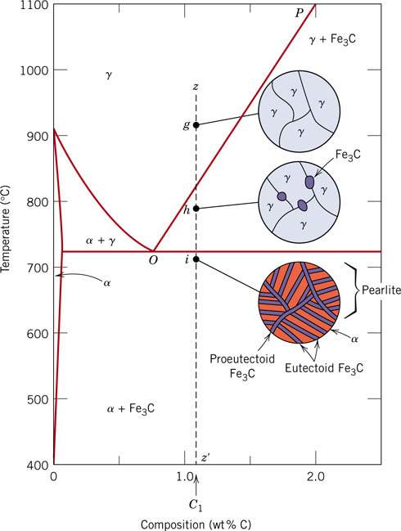
Hypereutectoid compositions >0.76wt%C
On cooling the γ must begin to transform as soon as it enters the γ + Fe₃C phase field.
Pro-eutectoid Fe₃C is formed on the prior γ grain boundaries.
On cooling to the eutectoid temperature, the remaining γ (which now has the eutectoid composition) transforms to pearlite .
microstructure consists of both Fe₃C and pearlite.

Slide 10
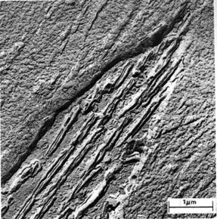
Bainite: Another Fe-Fe₃C Transformation Product
• Bainite:
-- elongated Fe₃C particles in
α-ferrite matrix
-- diffusion controlled
• Isothermal Transf. Diagram,
C₀ = 0.76 wt% C
Fe₃C
(cementite)
α
(ferrite)
800
Austenite (stable)
T(ºC)
T_{E}
A
P
5 μm
600
100% pearlite
Adapted from Fig. 10.17, Callister & Rethwisch 8e. (Fig. 10.17 from Metals Handbook, 8th ed., Vol. 8, Metallography, Structures, and Phase Diagrams, American Society for Metals, Materials Park, OH, 1973.)
100% bainite
400
A
B
200
0%
50%
100%
10
-1
10
10
3
10
5
Adapted from Fig. 10.18, Callister & Rethwisch 8e.
time (s)

Slide 11
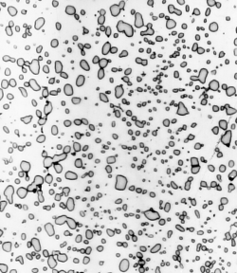
Spheroidite: Another Microstructure for the Fe-Fe₃C System
• Spheroidite:
-- Fe₃C particles within an α-ferrite matrix
-- formation requires diffusion
-- heat bainite or pearlite at temperature
just below eutectoid for long times
-- driving force – reduction
of α-ferrite/Fe₃C interfacial area
α
(ferrite)
Fe₃C
(cementite)
60 μm
Adapted from Fig. 10.19, Callister & Rethwisch 8e. (Fig. 10.19 copyright United States Steel Corporation, 1971.)

Slide 12
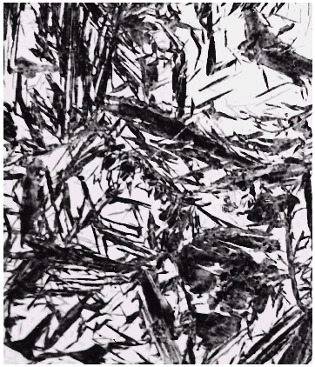
Martensite: A Nonequilibrium Transformation Product
• Martensite:
-- γ(FCC) to Martensite (BCT)
Fe atom
x
potential
sites
x
x
C atom sites
60 μm
x
x
x
Adapted from Fig. 10.20, Callister & Rethwisch 8e.
• Isothermal Transf. Diagram
800
Martensite needles
Austenite (stable)
Austenite
T(ºC)
T_{E}
A
P
Adapted from Fig. 10.21, Callister & Rethwisch 8e. (Fig. 10.21 courtesy United States Steel Corporation.)
600
Adapted from Fig. 10.22, Callister & Rethwisch 8e.
400
A
B
• γ to martensite (M) transformation..
-- is rapid! (diffusionless)
-- % transf. depends only on T to which rapidly cooled
100%
0%
50%
200
M + A
0%
M + A
50%
M + A
90%
10
-1
10
10
3
10
5
time (s)

Slide 13
Martensite Formation
γ (FCC) α (BCC) + Fe₃C
slow cooling
quench
tempering
M (BCT)
Martensite (M) – single phase
– has body centered tetragonal (BCT)
crystal structure
Diffusionless transformation BCT if C₀ > 0.15 wt% C
  BCT → few slip planes → hard, brittle

Slide 15
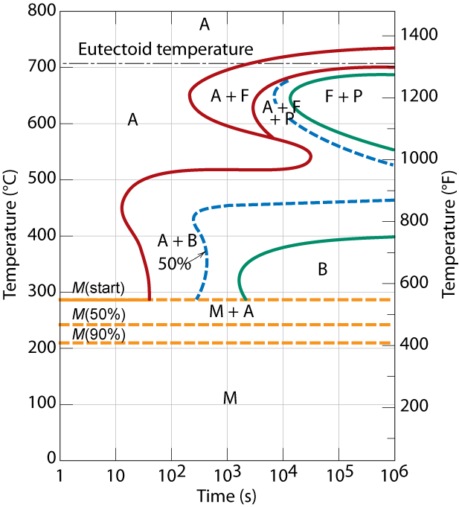
Phase Transformations of Alloys
Effect of adding other elements
  Change transition temp.
Cr, Ni, Mo, Si, Mn
retard γ → α + Fe₃C
reaction (and formation of pearlite, bainite)
Adapted from Fig. 10.23, Callister & Rethwisch 8e.

Slide 17
Summary of Possible Transformations
Adapted from Fig. 10.36, Callister & Rethwisch 8e.
Austenite (γ)
slow
moderate
rapid
cool
cool
quench
Pearlite
Bainite
Martensite
(α + Fe₃C layers + a
(α + elong. Fe₃C particles)
(BCT phase
proeutectoid phase)
diffusionless
transformation)
Martensite
reheat
T Martensite
bainite
Tempered
Strength
fine pearlite
Ductility
Martensite
coarse pearlite
(α + very fine
spheroidite
Fe₃C particles)
General Trends

Slide 18
Phase transitions
Aluminum-copper alloys
Harry Bhadeshia
Haixue Yan
photograph courtesy of Sunita Hansraj from her Antarctica expedition

Slide 19
Ref: Phase transformations in metals and alloys, third edition, DAVID A. PORTER, KENNETH E. EASTERLING, and MOHAMED Y. SHERIF

Slide 21
Ref: Phase transformations in metals and alloys, third edition, DAVID A. PORTER, KENNETH E. EASTERLING, and MOHAMED Y. SHERIF

Slide 22
Ref: Phase transformations in metals and alloys, third edition, DAVID A. PORTER, KENNETH E. EASTERLING, and MOHAMED Y. SHERIF

Slide 23
Ref: Phase transformations in metals and alloys, third edition, DAVID A. PORTER, KENNETH E. EASTERLING, and MOHAMED Y. SHERIF

Slide 24

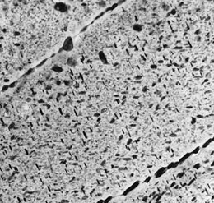
Example: Al-Cu alloy
Precipitation hardening
• Internal wing structure on Boeing 767
Adapted from chapter-opening photograph, Chapter 11, Callister 5e. (courtesy of G.H. Narayanan and A.G. Miller, Boeing Commercial Airplane Company.)
• Aluminum is strengthened with precipitates formed by alloying.
Adapted from Fig. 11.26, Callister 7e.
(Fig. 11.26 is courtesy of G.H. Narayanan and A.G. Miller, Boeing Commercial Airplane Company.)
1.5μm
Ref: Materials Science and Engineering,
I version, William D. Callister, David G. Rethwisch

Slide 25
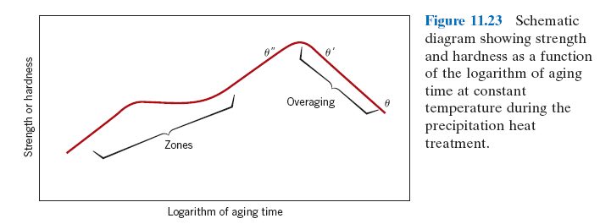
Effect on phases and mechanical properties
α’→ GP (Gunnier-Preston ) zones→θ”→θ’→CuAl₂(θ)
GP: fine scale enrichment with Cu atoms
θ” : fine scale precipitate, large locale lattice distortion, coherent, elastic, very effective barriers to dislocation movement, peak hardness
θ’ : as θ” disappear θ’ form. Partially coherent, hardness reduces
θ : CuAl₂ precipitate, equilibrium phase.
Ref: Materials Science and Engineering,
I version, William D. Callister, David G. Rethwisch

Slide 26
Optimum heat treatment
A series of experiments should be done by tempering the quenched samples at different temperatures and different duration. Then the yield strength or hardness of the samples should be measured and plotted as in the sketch.
Ref: Materials Science and Engineering,
I version, William D. Callister, David G. Rethwisch

Slide 27
PBL
Describe, with the aid of sketches, the heat treatments, phase diagram, microstructure and mechanical properties for the precipitation hardening of Al-Cu alloys. Your answer should identify the important requirements to achieve good precipitation hardening.

